Slide 1


Slide 2


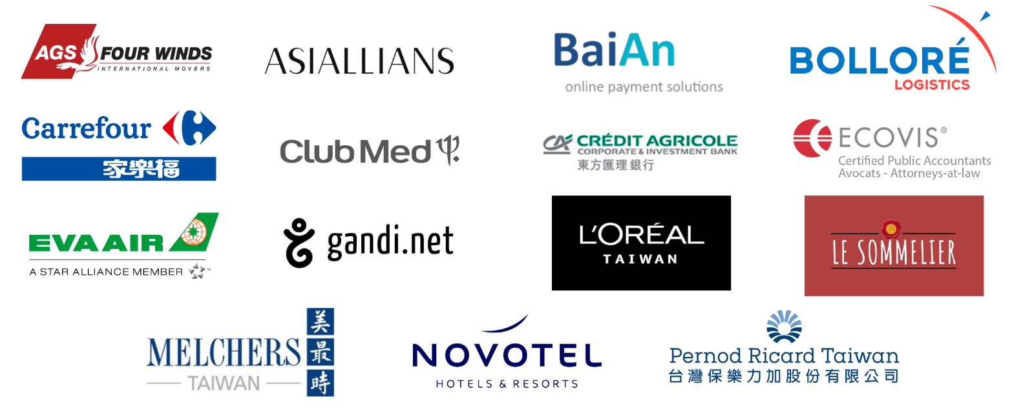
2019 Benefactor Members

Slide 3
Wednesday, April 10th 2019
The Sherwood Hotel
2019
General Assembly

Slide 4

General Assembly Agenda
18:00 - 18:30
Reception
18:30 - 18:35
Welcome Remark by Chairman of the CCIFT, Mr. Tudor PASCU
18:35 - 18:40
Address by Mr. Benoît GUIDEE, Director of the French Office in Taipei
18:40 – 18:50
Economic updates given by Mr. Alain BERDER, Head of Economic Department of French Office in Taipei
18:50 - 19:10
Annual Report Presentation by Mr. Stéphane PEDEN, CCIFT General Manager
19:10 - 19:20
Financial Report by Mr. Joël CICERON in the name of Mr. Christophe MARION
19:20 - 19:25
Address by Mr. Christian LAUDET, CCIFT Supervisor
19:25 - 19:35
Questions and Answers
19:35 – 19:50
Election of the Members of the Executive Committee & Election of the Supervisor
19:50 - 20:30
Networking, Buffet Dinner
20:30 - 21:30
Buffet Dinner and
Election Results Announcement

Slide 5
Welcome Remark by
Mr. Tudor PASCU
CCIFT Chairman

Slide 6

Address by
Mr Benoît GUIDEE,
Director of the
French Office in Taipei

Slide 7
Economic updates given by
Mr. Alain BERDER,
Head of Economic Department of French Office in Taipei

Slide 8
Update on Taiwan’s economic situation
CCIFT General Assembly
April 10th , 2019
8
Notes:
8

Slide 9












Taiwan is still the 6th largest Asian economy
Japan 5,071 (3rd)
Mainland China 13,457 (2nd)
India 2,690 (7th)
Korea 1,656 (11th)
Indonesia
1,005 (16th)
Taiwan 589 (21st)
Thailand
490 (25th)
Hong Kong
360 (35th)
Malasia
347 (37th)
Singapore
346 (38th)
Philippines
332 (40th)
Nominal GDP in bnUSD
Source: IMF, 2018
9
Notes:
9

Slide 10
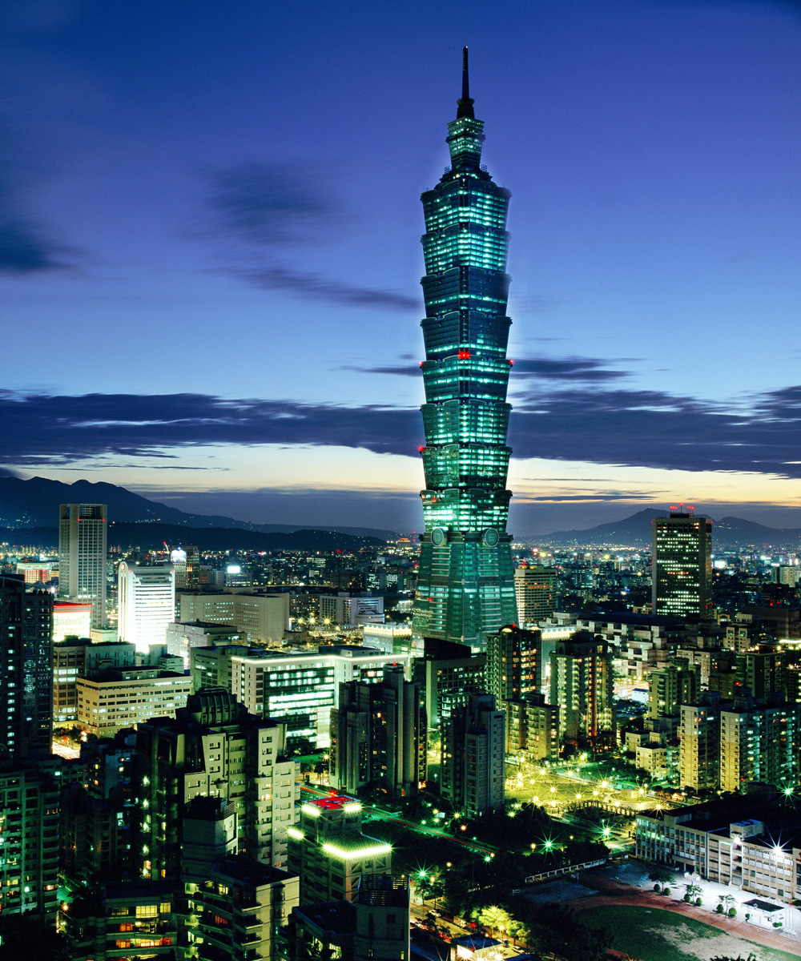
Some key figures about the Taiwanese economy
TAIWAN, 5th ECONOMIC POWER IN ASIA
A SIZEABLE ECONOMY
Taiwan GDP in 2018 : 589 Md USD (+2,63%)
World’s 21st largest economy
World’s 5th largest foreign currency reserve : 464 bn USD (CBC)
Foreign currency deposited in domestic banks : 1 trillion USD (2019)
Industry still accounts for 35% of GDP (services: 63%)
Exports (USD 394 bn) amounts to 67% of GDP
A LARGE POTENTIAL MARKET
Relatively high revenues
  Asia’s 6th GDP per capita: 25,004 USD (France: 42,930 USD)
  In PPP terms: 49,827 $ / capita (France: 43,550 $)
World’s 18th largest exporter and 19th largest importer of goods
10

Slide 11
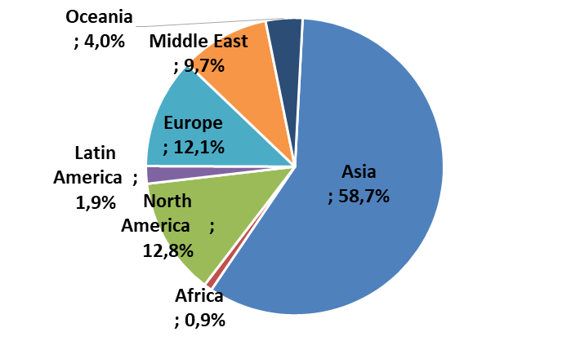
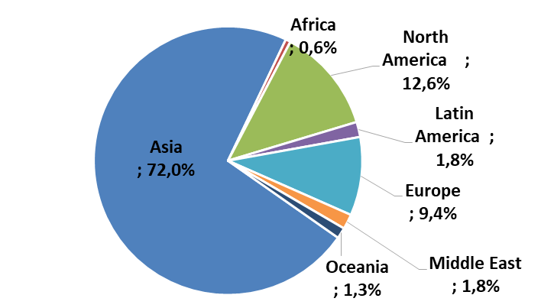
Taiwan’s Foreign Trade Partners
Taiwanese imports by origin in 2018
Mainland China & HK: 19,3%
Japan: 15,4%
Asean-6: 12,0%
EU 28: 9,7%
USA: 12,1%
Taiwanese exports by destination in 2018
Mainland China & HK: 41,2%
Asean-6: 17,3%
Japan: 6,9%
EU 28: 8,8%
USA: 11,8%
Source : MOF, BOFT
11
Notes:
11

Slide 12
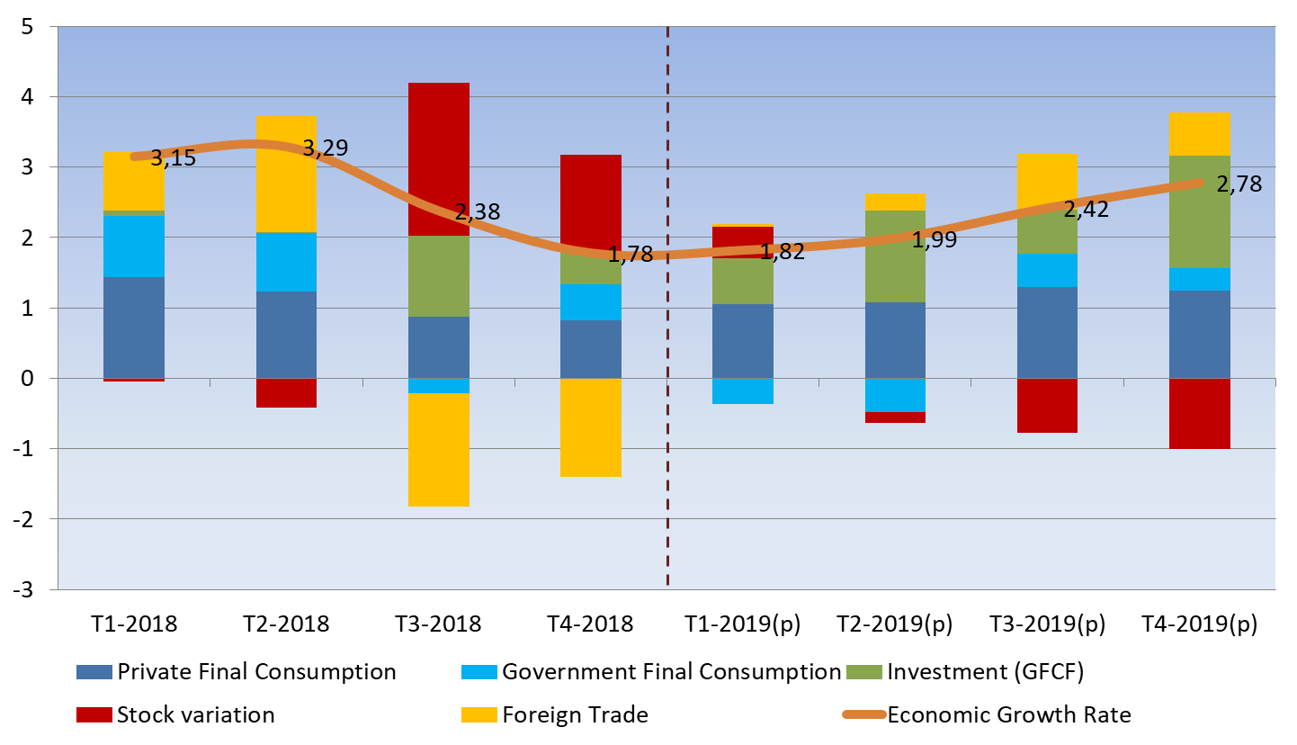
The growth dynamic in 2018-2019
Source : DGBAS
12
Notes:
12

Slide 13
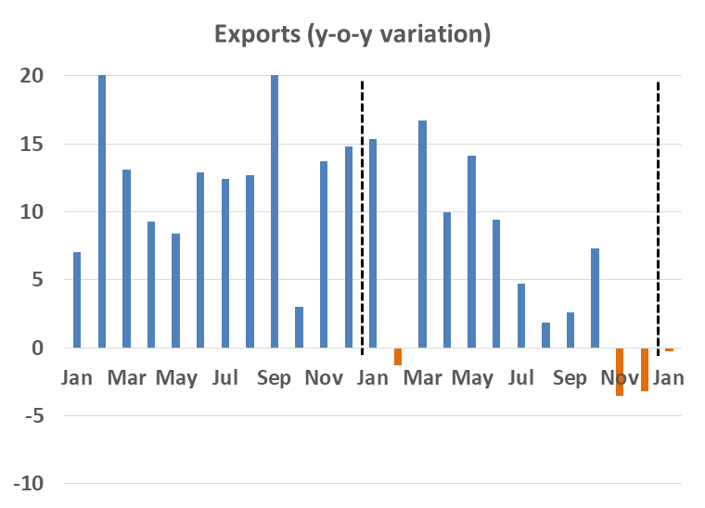
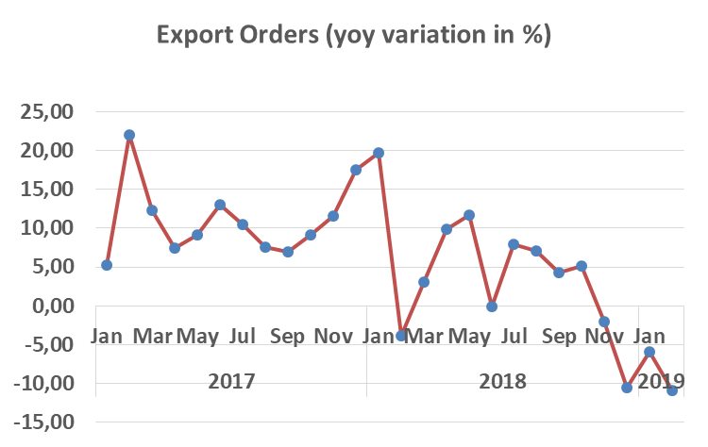
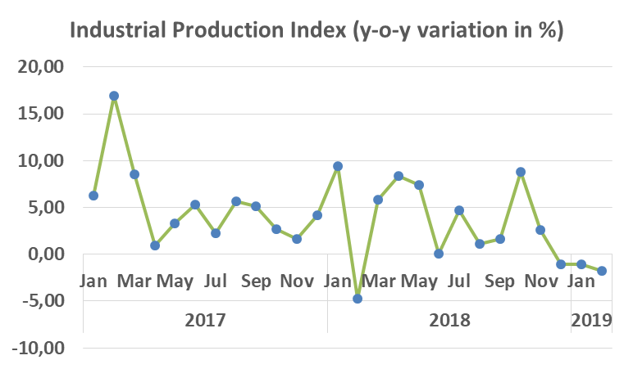
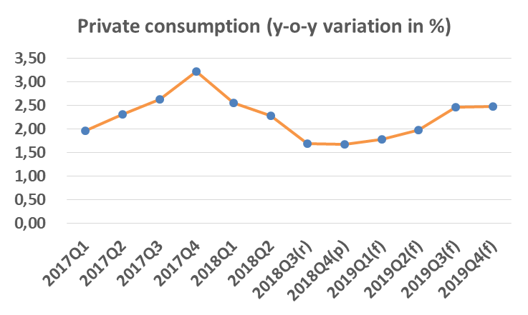
Where are we going? Short term perspectives
6
Source : MOEA, March 2019
Notes:
13

Slide 14
Official Forecast for 2019
 | 2016 | 2017 | 2018 | 2019(f)*
Economic Growth | +1,51% | +3,08% | +2,63% | +2,27%
Inflation | 1,39% | 0,62% | 1,35% | 0,73%
Unemployment | 3,92% | 3,76% | 3,71% | -
Private final consumption (yoy) | +2,37% | +2,54% | +2,05% | +2,18%
Investment (GFCF) (yoy) | +2,36% | -0,12% | +2,10% | +5,00%
Government final consumption (yoy) | +3,60% | -0,63% | +3,51% | -0,03%
Exports (FOB) | -1,76% | +13,17% | +5,92% | +0,19%
Imports (CIF) | -2,80% | +12,45% | +10,55% | -0,95%
Balance (Bn USD) | 49,7 | 57,9 | 49,4 | 52,7
Source : DGBAS (*) : forecast for 2019 (updated on Feburary 13th 2019)
7
Notes:
14

Slide 15
Taiwan in international rankings 2018
Competitiveness : 13th most competitive economy according to WEF (SGP : 2nd ; HK: 7th).
Business Environment: 13th best in WB’s Doing Business 2019 (SGP: 2nd ; HK: 4th ; SK: 5th).
In the Heritage Foundation’s Index of Economic Freedom for 2019, Taiwan ranked 10th out of 186 countries, ahead of South Korea (27), Japan (30), and Israel (31) but behind HG(1), SGP(2).
Taiwan’s GINI Index (which measures the income gap between rich and poor) indicates it actually ranks in the top third of countries with the smallest gaps (112th place according to World Factbook).
Taiwan ranked 6th in 2018 in number of patents granted by USPTO and also ranked 5th in 2017 in USPTO nanotechnology patents.
Taiwan maintained its global lead in integrated circuit 200mm-equivalent wafer fab capacity for the 4th consecutive year: as of December 2018, Taiwan enjoyed a global share of 21.8%, ahead of South Korea (21.3%), Japan (16.8%), North America (12.8%), and China (12.5%).
According to the InterNations survey, Taiwan ranked 2nd in 2018 in a survey of “Best Countries for Expats.”
The InterNations survey also gave Taipei a 1st place ranking in 2018 for the general friendliness of the Taiwanese and their positive attitude toward foreign residents.
15
Notes:
15

Slide 16
Conclusion
Taiwan’s GDP per capita exceeded, for the first time, 25 000 USD in 2018.
Nothing actually changed in 2018 but Taiwan is still facing major challenges in 2019 with global demand slowing down.
Time to change the “economic model”.
Promotion of Forward-Looking Infrastructure Development Program and action plan to welcome investments by Taiwanese companies abroad, both public and private investment, may continue to expand.
Need to upgrade Taiwanese industries and to diversify trade partners.
Solving Energy supply challenge should be a top priority.
Tackling social challenges both in the short term (housing, low salaries,…) and the long term (demographics).
Help foreign startups and SMEs to get financing from Taiwanese banks.
16
Notes:
16

Slide 17
THANKS FOR YOUR ATTENTION
17

Slide 18
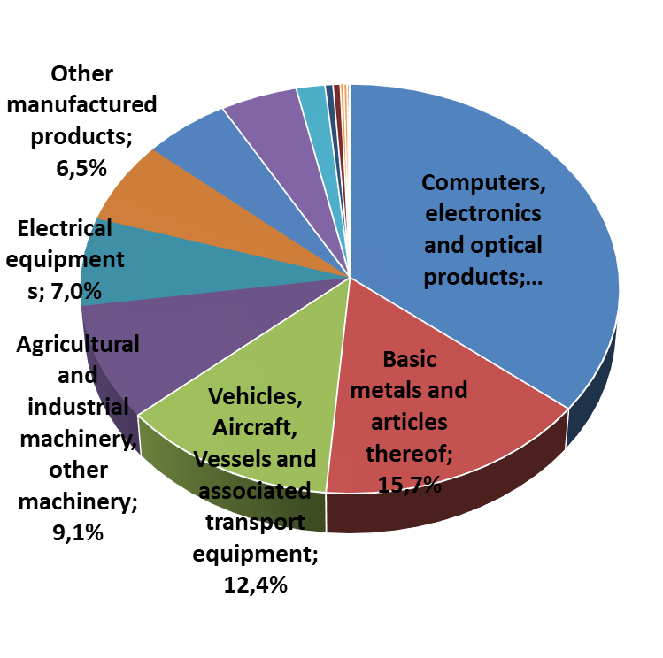
France’s foreign trade with Taiwan
French imports from Taiwan in 2018
Total Trade in 2018 : 4,7 bn EUR ( France, 20th trade partner of TW)
French imports : 2,52 bn EUR (20th client of TW)
French Exports : 2,18 bn EUR (16th supplier of TW)
Commodities | Value K euros (growth yoy)
Computers, electronics and optical products | 899 621 | -32,3%
Basic metals and articles thereof | 395 356 | +6,2%
Vehicles, Aircraft, Vessels and associated transport equipment | 311 944 | -6,5%
Agricultural and industrial machinery, other machinery | 228 857 | -5,7%
Electrical equipments | 175 356 | -1,4%
Other manufactured products | 164 452 | -5,6%
Rubber and plastic products, other mineral products | 137 718 | +1,6%
Chemicals, Perfumes and Cosmetics | 122 924 | +9,7%
Textile, Clothes, Leather, Shoes | 45 819 | -17,8%
Agroprocessing Industry | 12 603 | +3,9%
Total | 2 521 818 | -15,5%
Source : French Customs
18
Notes:
18

Slide 19
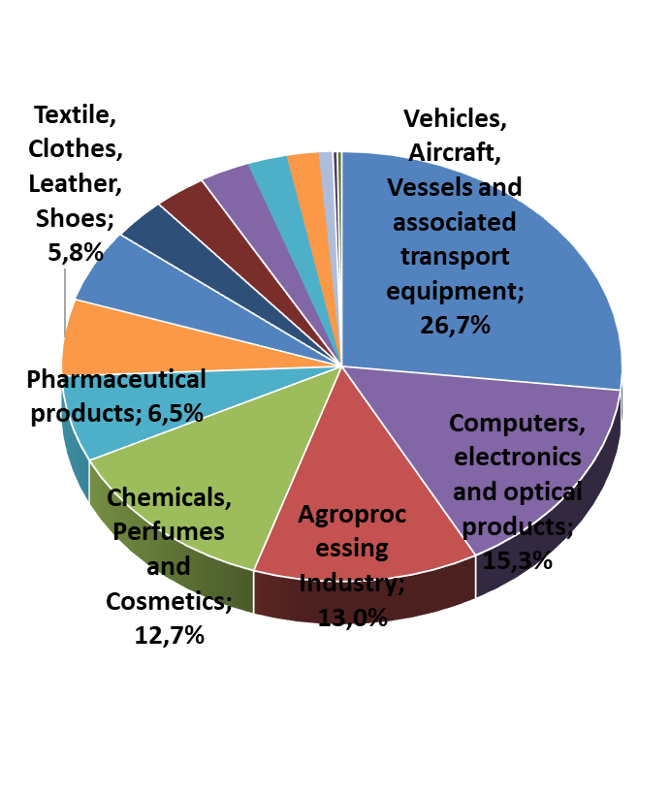
France’s foreign trade with Taiwan
French exports to Taiwan in 2018
Commodities | Value K euros (growth yoy)
Vehicles, Aircraft, Vessels and associated transport equipment | 583 448 | (-58,2%)
Computers, electronics and optical products | 333 548 | (+41,8%)
Agroprocessing Industry | 283 283 | (-0,1%)
Chemicals, Perfumes and Cosmetics | 276 883 | (+6,6%)
Pharmaceutical products | 141 462 | (+5,9%)
Textile, Clothes, Leather, Shoes | 125 608 | (+2,6%)
Agricultural and industrial machinery, other machinery | 119 249 | (+45,0%)
Basic metals and articles thereof | 68 460 | (+9,1%)
Electrical equipments | 49 771 | (+7,3%)
Rubber and plastic products, other mineral products | 39 953 | (-4,9%)
Total | 2 182 492 | (-21,3%)
Source : French Customs
19
Notes:
19

Slide 20
Annual Report Presentation
by Mr. Stéphane PEDEN,
CCIFT General Manager

Slide 21
Prezi Presentation

Slide 22


MAY 31st
HYATT

Slide 23
New Business Centre premises Opening
ON APRIL 24th
From 17:30 to 21:00

Slide 24
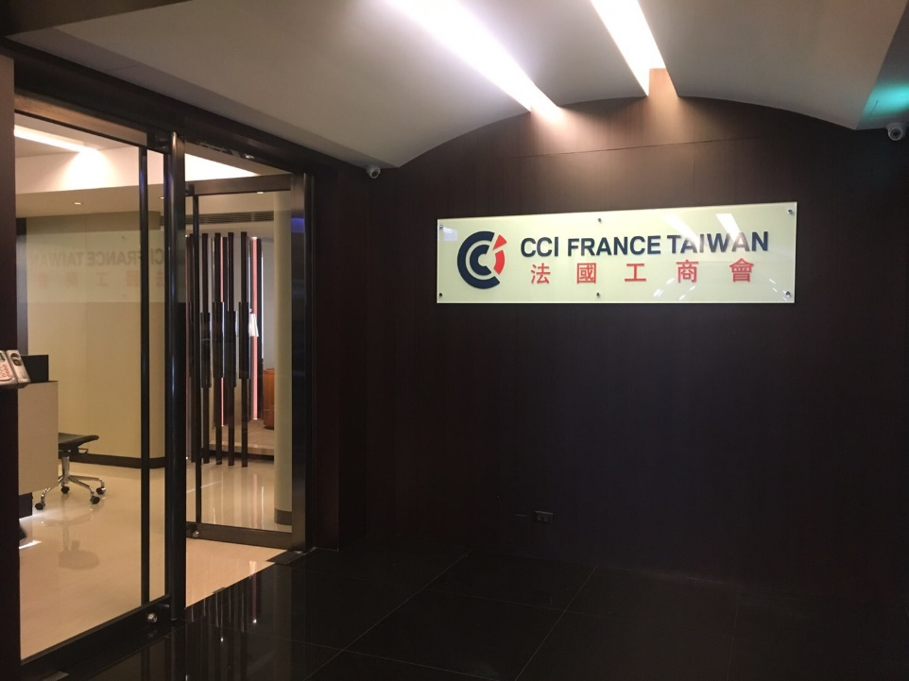
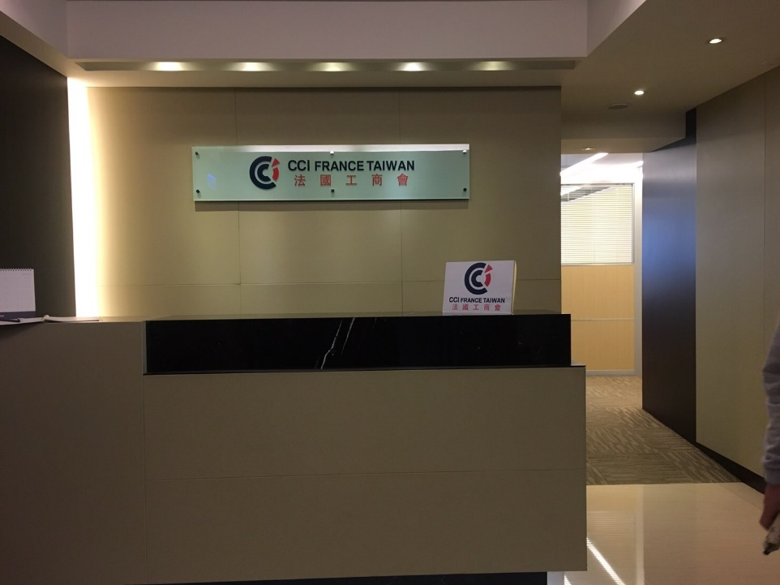

Slide 25
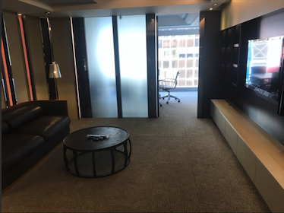
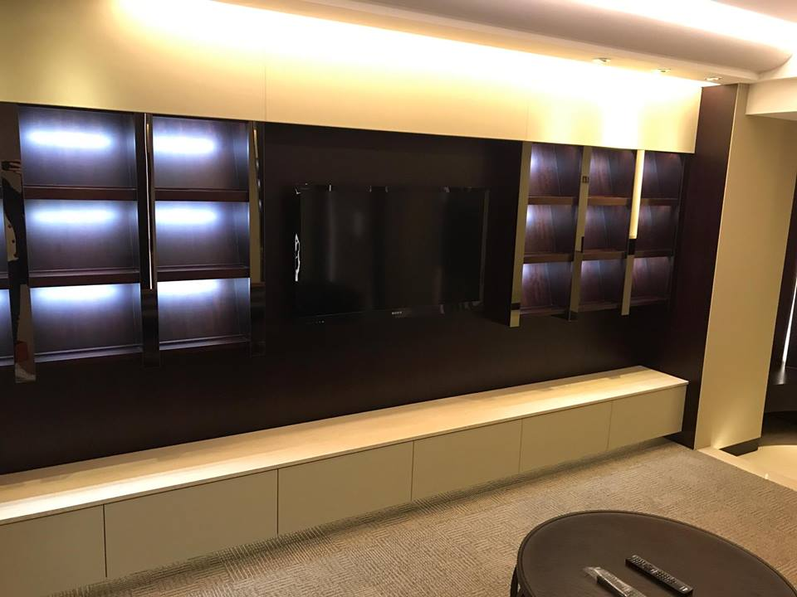

Slide 26
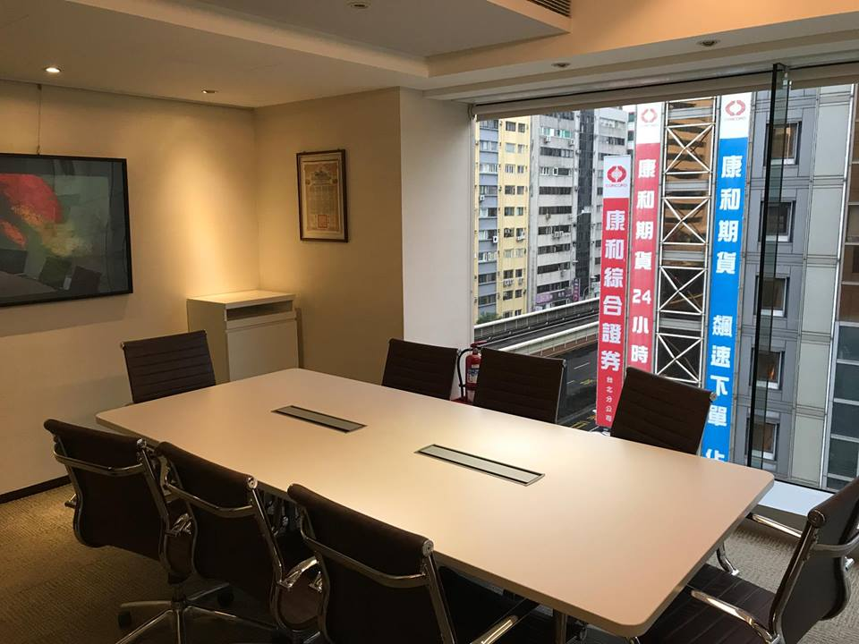
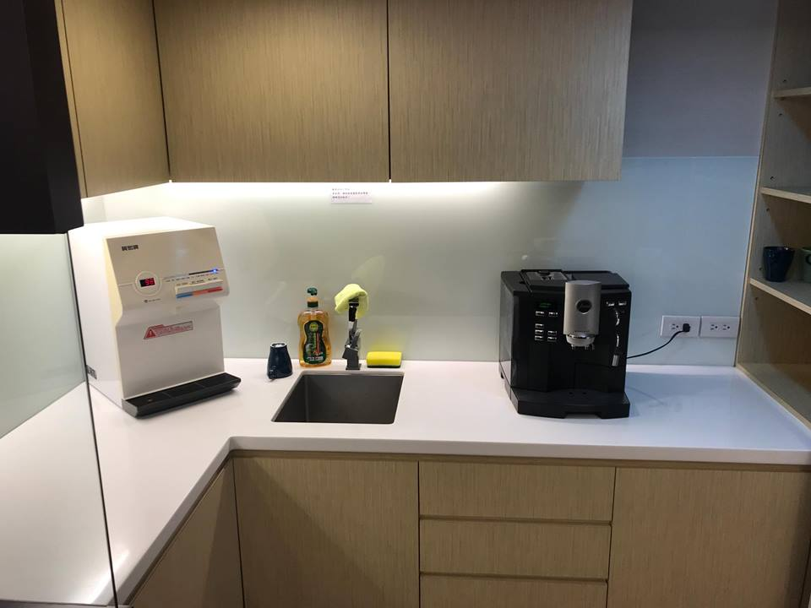
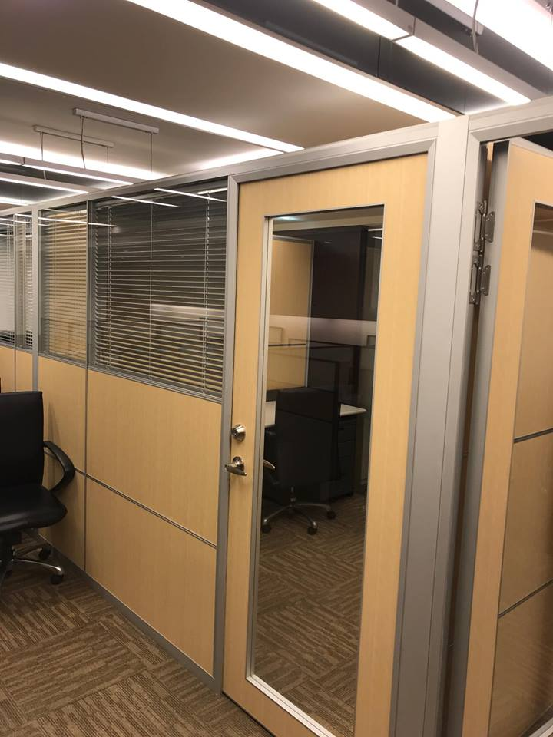
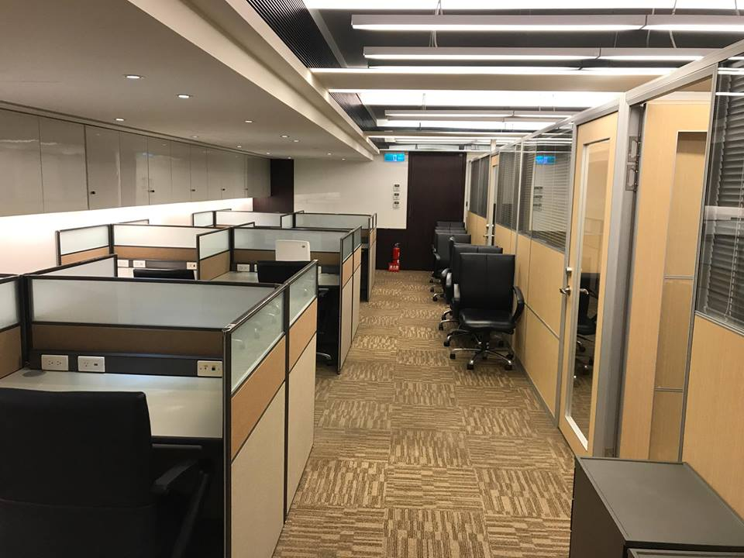

Slide 27
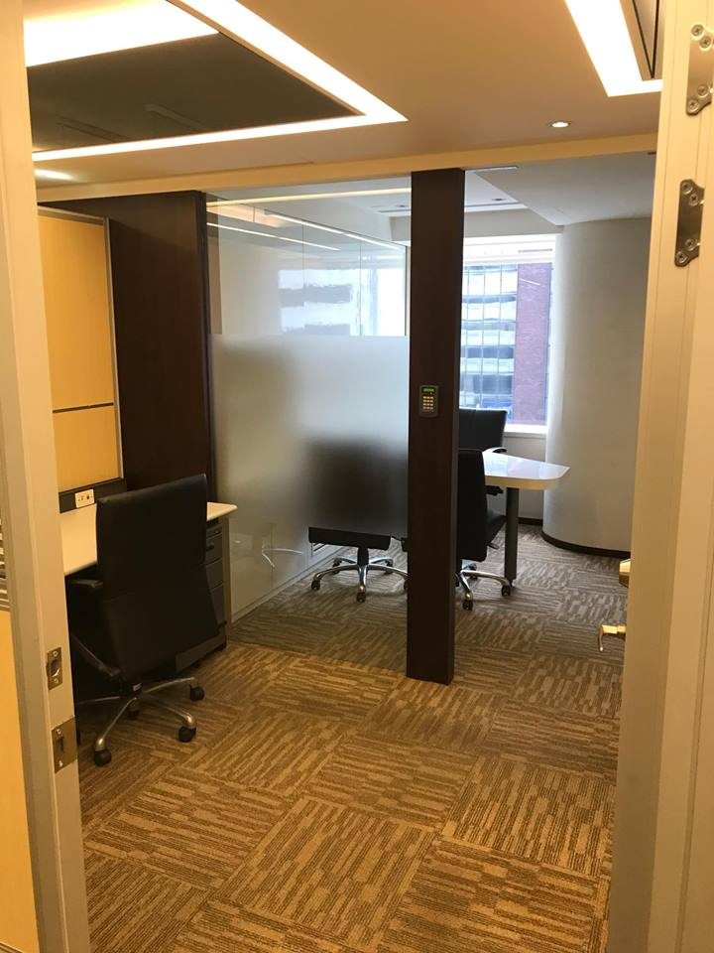
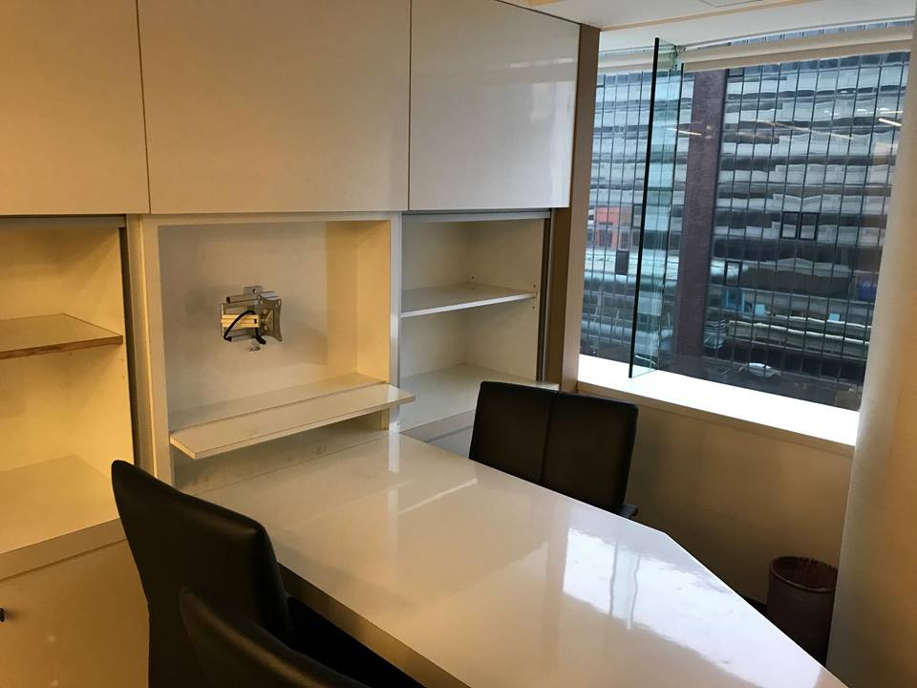
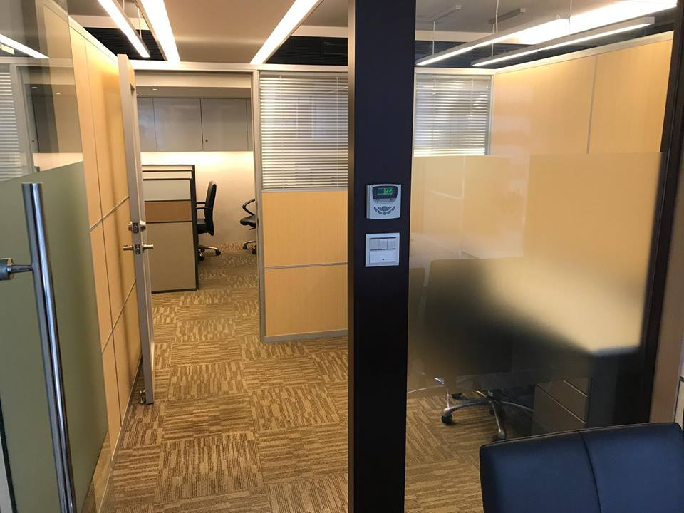
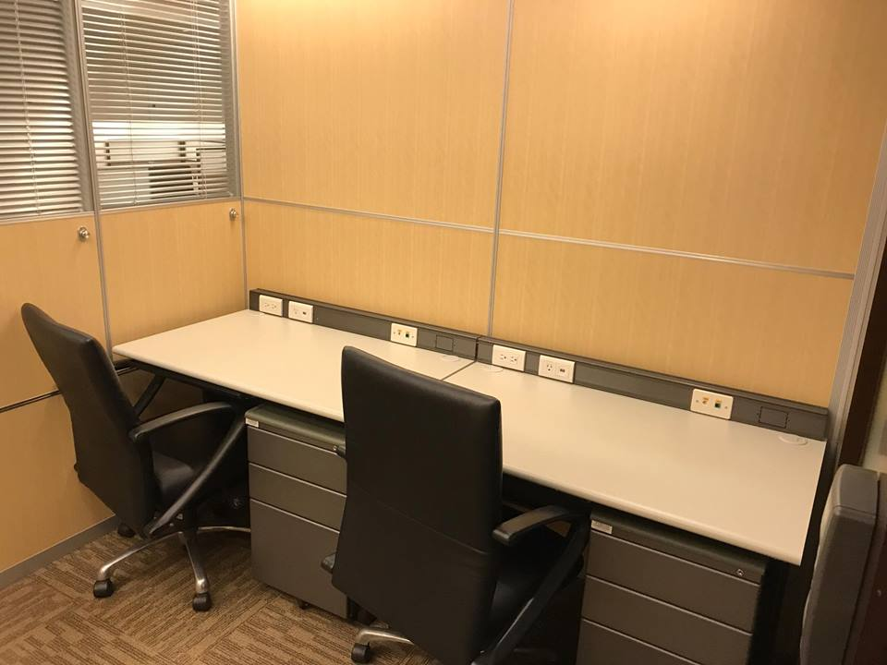

Slide 28
Financial Report by
Joël CICERON
CCIFT Secretary General
On behalf of
Christophe MARION
Treasurer

Slide 29
FRANCE TAIWAN CHAMBER OF COMMERCE AND INDUSTRY
2018 Financial Report

Slide 30
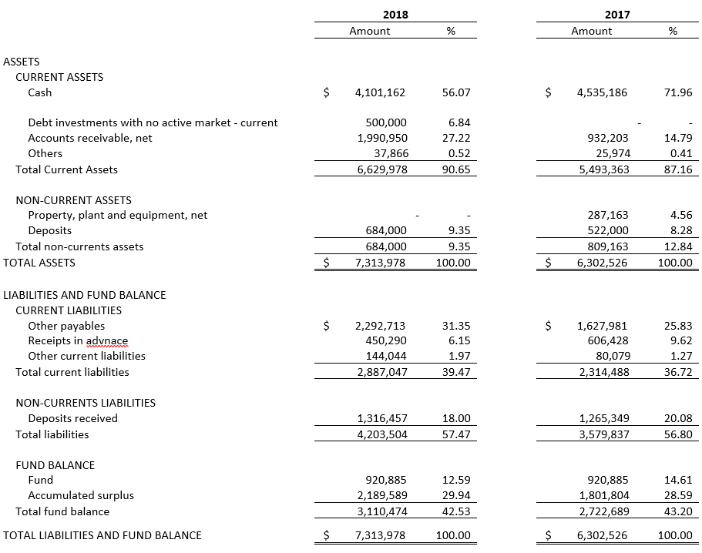
FRANCE TAIWAN CHAMBER OF COMMERCE AND INDUSTRY
BALANCE SHEETS
DECEMBER 31, 2018 AND 2017
(EXPRESSED IN NEW TAIWAN DOLLARS)
Notes:
Solid Balance Sheet
No more borrowing since 2016
In 2018, Cash Position 4.1M with also Saving Account 0.5M so Cash equivalent 4.6M on line with 2017

Slide 31
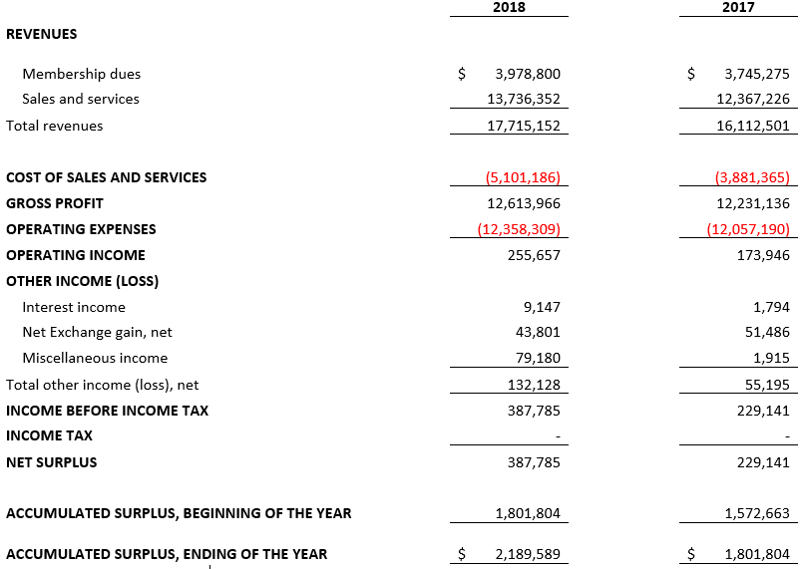
FRANCE TAIWAN CHAMBER OF COMMERCE AND INDUSTRY
STATEMENTS OF ACTIVITES AND FUND BALANCES
FOR THE YEARS ENDED DECEMBER 31, 2018 AND 2017
(EXPRESSED IN NEW TAIWAN DOLLARS)
Notes:
Net Surplus of the Year 387K, a little bit over 2017 at 229K, +69% progression
Will come back on the presentation on the detail of Revenues and Costs

Slide 32
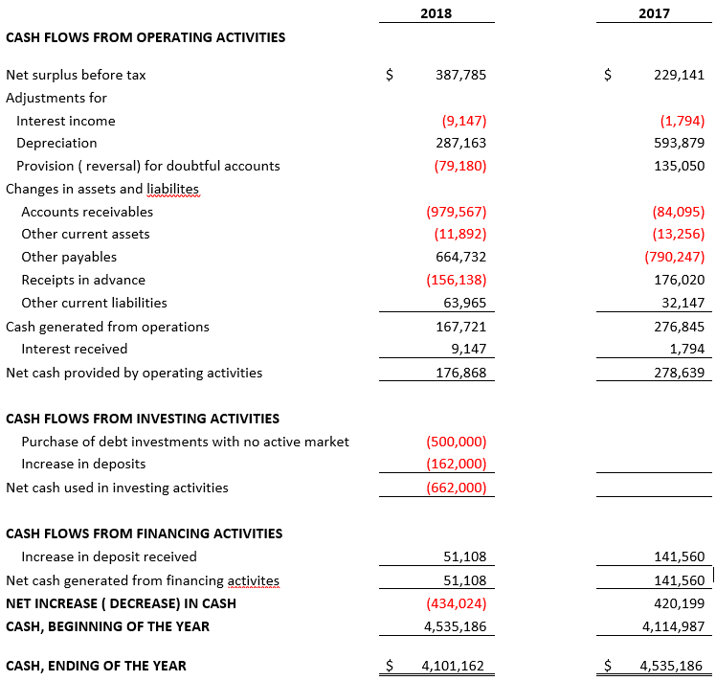
FRANCE TAIWAN CHAMBER OF COMMERCE AND INDUSTRY
STATEMENTS OF CASH FLOWS
FOR THE YEARS ENDED DECEMBER 31, 2018 AND 2017
(EXPRESSED IN NEW TAIWAN DOLLARS)
The financial statement for the year ended the December, 31st 2018
They have been audited by JYH HER CPAS
Members can request a copy of the Auditor's Report by contacting Mathilde LIAO
At 02-2721 7599 ext.33
By sending an email to admin@ccift.org.tw
Notes:
Note that we have cash out of 500k corresponding to Saving Account (named “purchase of debt investments”). It is cash equivalent as mentioned before
The increase of deposits corresponds of 162K corresponds to the increase of deposits for our lease on historical business center in Fushing Road. The lease increased +40% since April 2018
The Cash position at 4.1M vs 4.5M in 2017. If including Saving Account 500K, equivalent cash 4.6M on line with 2017

Slide 33


REVENUES +10% TWD17.71m (FY2017: TWD16.1m)
20%
29%
21%
23%
Notes:
Revenues increasing +10%
Without payroll support for European Education Fair stopped in 2016 (in green), this is the highest ever Revenue!

Slide 34




REVENUES +10% TWD17.71m (FY2017: TWD16.1m)
 |  |  |  | FY2018 | FY2017
 | MEMBERSHIP | 23% |  | TWD4.0m | TWD3.7m
 | BUSINESS CENTER | 32% |  | TWD5.6m | TWD5.3m
 | ENTERPRISE SUPPORT | 15% |  | TWD2.7m | TWD2.9m
 | EVENTS | 30% |  | TWD5.4m | TWD4.1m
+6%
20%
29%
+6%
21%
-7%
23%
+30%
Notes:
Decrease in Enterprise Support -7%, because in 2017 we received a subsidy from CCI France for organizing CCI Asia Seminar (240k)
Steady growth +6% in Membership and Business Center:
->More Members in 2018
->More virtual and full occupancy open desks Tenants
Significant increase for the Events at +30%
-> Steady growth for our major events Gala and Beaujolais
->1 new tailor made event for Member Michelin during Christmas

Slide 35

COSTS & EXPENSES +9.5% TWD17.46m (FY2017: TWD15.53m)
20%
29%
21%
23%
Notes:
The cost (+9.5%) are increasing slightly lower than the revenues (+10%)

Slide 36
COSTS & EXPENSES +9.5% TWD17.46m (FY2017: TWD15.53m)
20%
29%
21%
23%
Costs & Expenses under control
Notes:
29% of the costs are Operating Costs and 71% Operating Expenses
Within Operating Expenses, 49% of personal related expenses, 37% from rental office and 14% from other administrative expenses
The rental of our historical business center in Fushing Road increased by 40% since April 2018

Slide 37

NET INCOME +69 % TWD387,785 (FY2017: TWD229,141)
20%
29%
21%
23%
healthy Net Income
Notes:
As a results we had a healthy net income, progressing +69% vs 2017

Slide 38

CASH POSITION TWD4.10m (FY2017: TWD4.54)
20%
TWD4,101,162
29%
21%
23%
robust Cash Position
Notes:
The cash position is strong at 4.1M (4.6M cash equivalent including saving account)
The cash position currently in April 2019 is at the same level of last year, despite Deposit (440K) and Capex (600K) spent for the 2nd business Center opened in March 2019

Slide 39

STABLE FINANCIAL SITUATION
net income | at its highest level
no debt | 0
no public subsidies | 0
strong liquidity | current ratio at 1.4
good profitability | gross profit margin at 71%
excellent cash position | TWD4.1m
Great position to navigate the future!
Notes:
Liquidity ratio: cash 4,101,162 divided by Total current liabilities 2,887,047 – can be between 0.2 (quite risky) to 1 – ability to pay debt – higher than 5 too much cash!

Slide 40
FRANCE TAIWAN CHAMBER OF COMMERCE AND INDUSTRY
Thank you for your attention

Slide 41
Address by
Mr Christian LAUDET,
CCIFT Supervisor

Slide 42
Questions & Answers

Slide 43
Election Agenda
Election of the Board Members & Supervisor
•
Networking
•
Election Results
•
Buffet Dinner

Slide 44
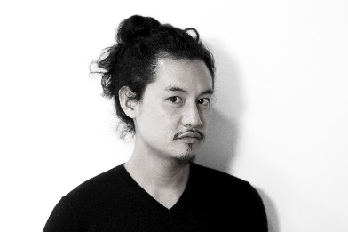
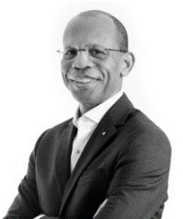
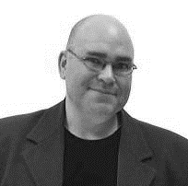
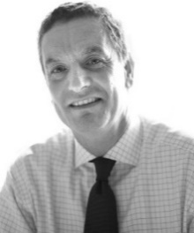
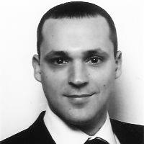
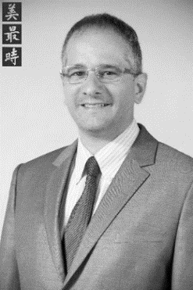
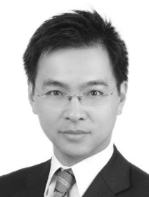
Candidates for 2019
For Board of Directors Position:
Manu
CHEN
E. Joël
CICÉRON
Elias
EK
Denis
FORMAN
Pauline
FRISON
Elias
KAZI-AOUAL
Christophe
MARION
Tudor
PASCU
Pascal
THIEN-AH-KOON

Slide 45
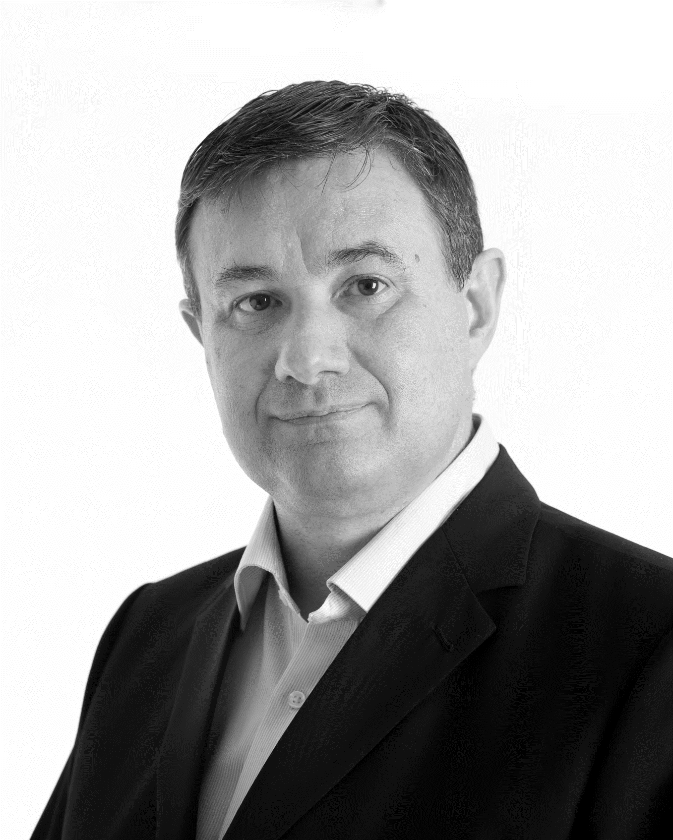
Candidates for 2019
For Board of Supervisor Position:
Christian
LAUDET

Slide 46
Kindly on your way out,
please place your vote(s) in the Ballot Box
Thank You

Slide 47










2018 Benefactor Members

